Slide 1
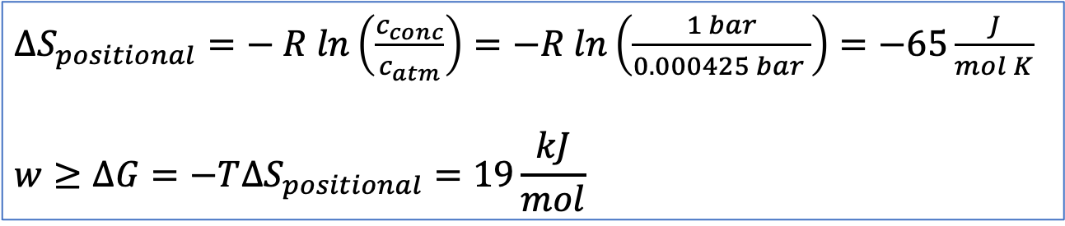



Last week we used the idea that $∆G$ tells us about the non-PV work needed to concentrat $CO_{2}$ from the atmosphere
$∆S_{positional}=− R ln\left(\frac{c_{conc}}{c_{atm}}\right)=−R ln\left(\frac{1 bar}{0.000425 bar }\right)=−65\frac{J}{mol K}$
$$w≥∆G=−T∆S_{positional}=19\frac{kJ}{mol}$$
$$P_{init}=0.00042 bar$$
Reduced positional entropy
$$P_{final}=1 bar$$
We’re saying $w≥19\frac{kJ}{mol}$ because in real life, inefficiencies in how this is engineered means that this $∆G$is a lower thermodynamic limit on the work needed.

Slide 2
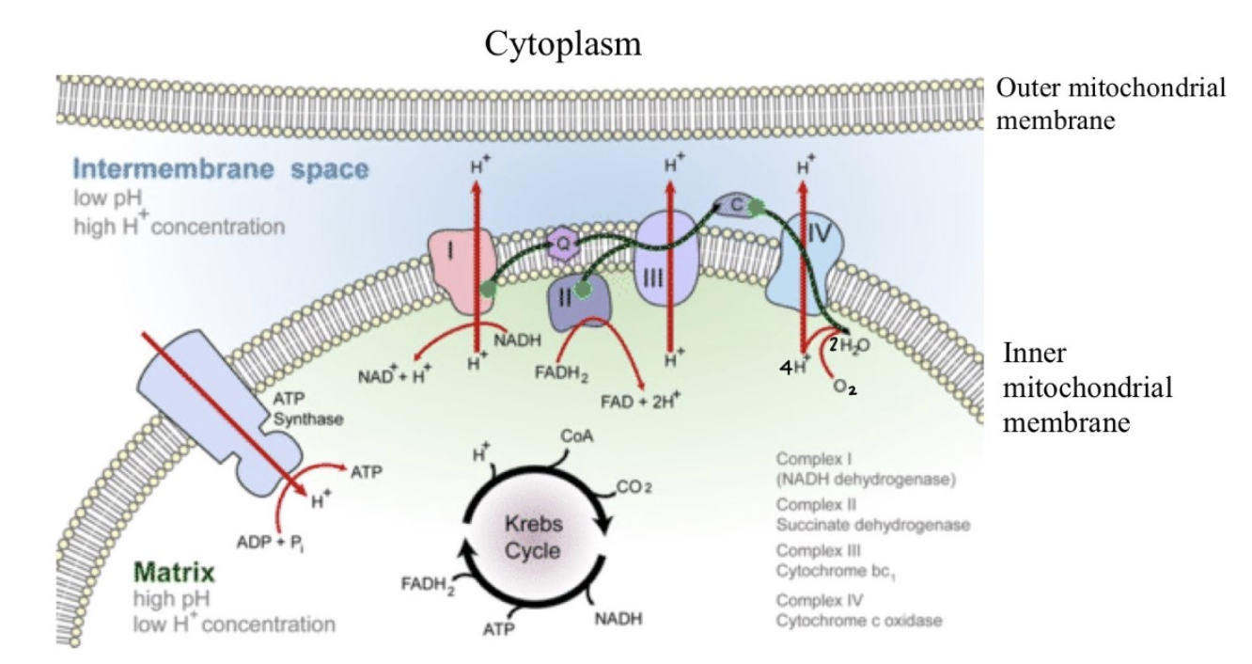



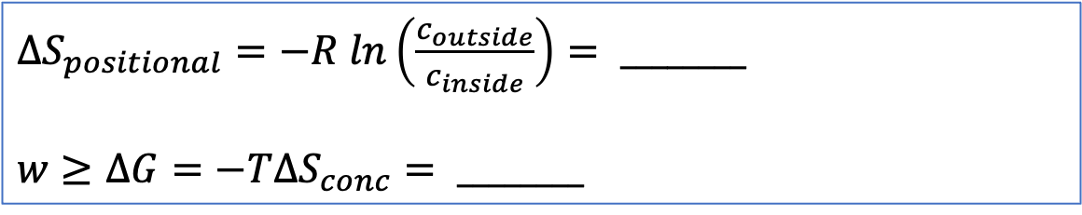
But we can do this in biochemical systems too: transport of $H^{+}$ across a mitochondrial cell wall
$∆S_{positional}=−R ln\left(\frac{c_{outside}}{c_{inside}}\right)= ________$
$$w≥∆G=−T∆S_{conc}= ________$$
$$pH=7$$
$$pH=7.5$$
Let’s do some predicting …
Should $∆S_{positional}$ be positive or negative?

Slide 3
But we can do this in biochemical systems too: transport of $H^{+}$ across a mitochondrial cell wall
$∆S_{positional}=−R ln\left(\frac{c_{outside}}{c_{inside}}\right)= ________$
$$w≥∆G=−T∆S_{conc}= ________$$
$$pH=7$$
$$pH=7.5$$
Let’s do some predicting …
Should $∆S_{positional}$ be positive or negative? ($∆S_{positional}<0$, more crowded)

Slide 4

But we can do this in biochemical systems too: transport of $H^{+}$ across a mitochondrial cell wall
$∆S_{positional}=−R ln\left(\frac{c_{outside}}{c_{inside}}\right)= ________$
$$w≥∆G=−T∆S_{conc}= ________$$
$$pH=7$$
$$pH=7.5$$
Let’s do some predicting …
Should $∆S_{positional}$ be positive or negative? ($∆S_{positional}<0$, more crowded)
Should $∆G$ be positive or negative?

Slide 5

But we can do this in biochemical systems too: transport of $H^{+}$ across a mitochondrial cell wall
$∆S_{positional}=−R ln\left(\frac{c_{outside}}{c_{inside}}\right)= ________$
$$w≥∆G=−T∆S_{conc}= ________$$
$$pH=7$$
$$pH=7.5$$
Let’s do some predicting …
Should $∆S_{positional}$ be positive or negative? ($∆S_{positional}<0$, more crowded)
Should $∆G$ be positive or negative? ($∆G>0$, requires input of work)

Slide 6
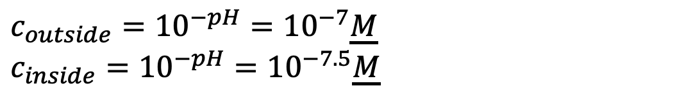
But we can do this in biochemical systems too: transport of $H^{+}$ across a mitochondrial cell wall
$∆S_{positional}=−R ln\left(\frac{c_{outside}}{c_{inside}}\right)= ________$
$$w≥∆G=−T∆S_{conc}= ________$$
$$pH=7$$
$$pH=7.5$$
$c_{outside}={10}^{−pH}={10}^{−7}\underline{M}$
$c_{inside}={10}^{−pH}={10}^{−7.5}\underline{M}$

Slide 7
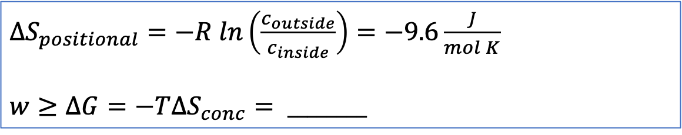


But we can do this in biochemical systems too
$∆S_{positional}=−R ln\left(\frac{c_{outside}}{c_{inside}}\right)=−9.6\frac{J}{mol K}$
$$w≥∆G=−T∆S_{conc}= ________$$
$$pH=7$$
$$pH=7.5$$
$c_{outside}={10}^{−pH}={10}^{−7}\underline{M}$
$c_{inside}={10}^{−pH}={10}^{−7.5}\underline{M}$

Slide 8
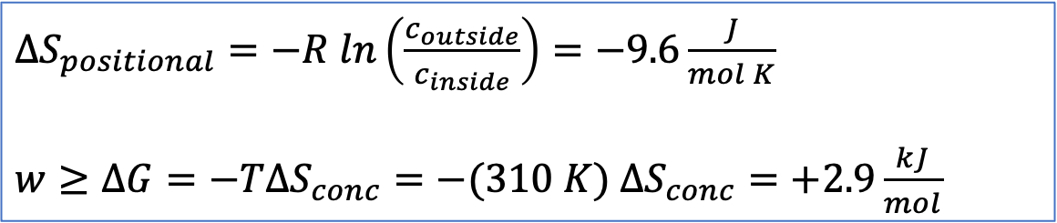
But we can do this in biochemical systems too
$∆S_{positional}=−R ln\left(\frac{c_{outside}}{c_{inside}}\right)=−9.6\frac{J}{mol K}$
$w≥∆G=−T∆S_{conc}=−(310 K) ∆S_{conc}=+2.9\frac{kJ}{mol}$
$$pH=7$$
$$pH=7.5$$
$c_{outside}={10}^{−pH}={10}^{−7}\underline{M}$
$c_{inside}={10}^{−pH}={10}^{−7.5}\underline{M}$

Slide 9
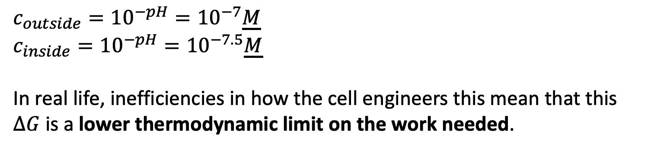
But we can do this in biochemical systems too
$∆S_{positional}=−R ln\left(\frac{c_{outside}}{c_{inside}}\right)=−9.6\frac{J}{mol K}$
$w≥∆G=−T∆S_{conc}=−(310 K) ∆S_{conc}=+2.9\frac{kJ}{mol}$
$$pH=7$$
$$pH=7.5$$
$c_{outside}={10}^{−pH}={10}^{−7}\underline{M}$
$c_{inside}={10}^{−pH}={10}^{−7.5}\underline{M}$
In real life, inefficiencies in how the cell engineers this mean that this $∆G$is a lower thermodynamic limit on the work needed.

